Slide 1


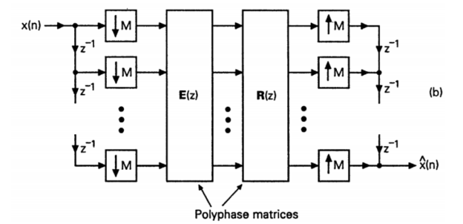

Implementation Polyphase Three Channel FilterBank SignalReconstruction
Mohammad Reza
Mansouri

Slide 2
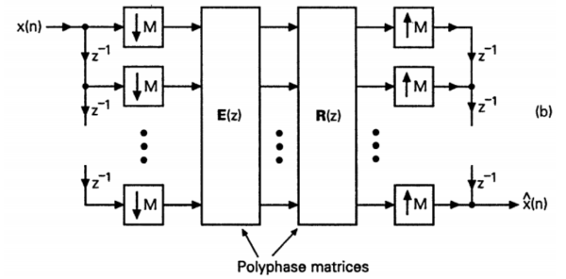
Introduction
1
In the simulation, for simplicity in design, coding is divided into two sections: analysis and synthesis.

Slide 3



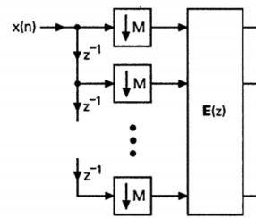
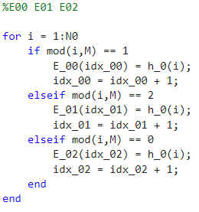
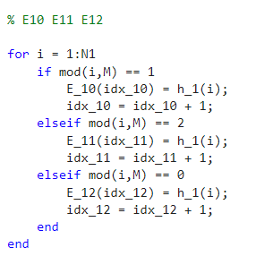
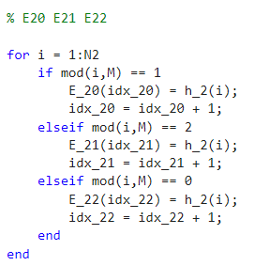
analysis
analysis
2

Slide 4
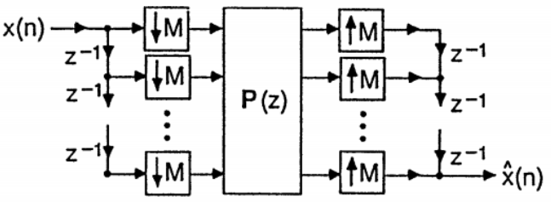

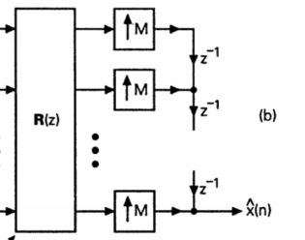
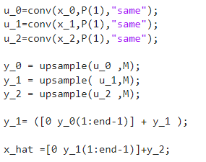

synthesis
2

Slide 5



MSE
3

Slide 6


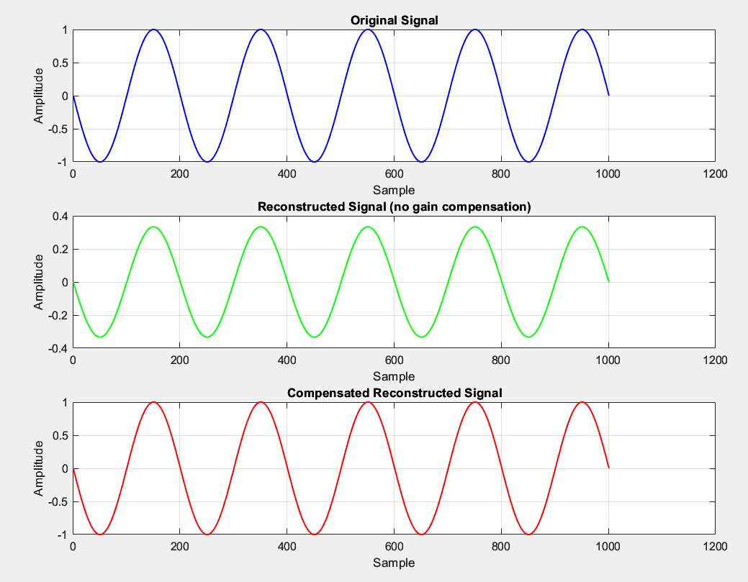
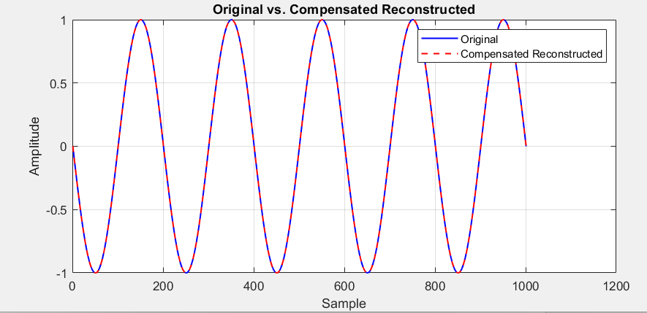
Results
3
The results are accurate, and the error between the input signal and the reconstructed signal is zero.

